Slide 1
British Airline Consumer Booking Predictive Model
Shahnaj Ullah

Slide 2
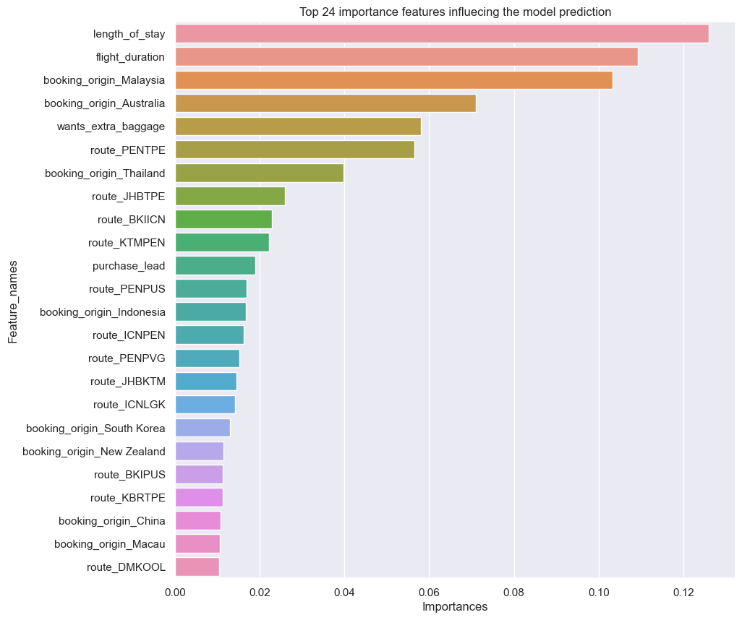
random Forest Tree Booking Predictor
A predictive model was successfully created with the goal of trying to predict whether a consumer completes their flight booking or not using the random forest tree algorithm.
This algorithm shows an accuracy of 85% on both the training and test sets.
As the dataset is quite large, a RandomizedSearchCV method was applied to find the best hyperparameters. The best fit hyperparameters were the following:
n_estimator = 25
min_samples_split = 5
min_samples_leaf = 1
max_features = ‘sqrt’
max_depth = 4
Bootstrap = True
The bar chart on the left presents in order of importance, the top 24 features with the most to least contribution on the outcome for the prediction model.
We can see the length of stay, flight duration, bookings originating from Malaysia and Australia, request for extra baggage and routes from PENTPE have the most contribution.

